Slide 1

CS1011 Computer Programming in Python
Lecture 2:Variables, Expressions, and Control Flow

Slide 2
Objectives
Variables, assignment, and naming conventions
Arithmetic operations and precedence
Comparison operators (==, !=, <, >, etc.)
Conditional statements (`if`, `elif`, `else`)

Slide 3
Variables
A variable is a named place in the memory where a programmer can store data and later retrieve the data using the variable “name”
Programmers get to choose the names of the variables
You can change the contents of a variable in a later statement
12.2
x = 12.2
y = 14
x
14
y

Slide 4
Variables
A variable is a named place in the memory where a programmer can store data and later retrieve the data using the variable “name”
Programmers get to choose the names of the variables
You can change the contents of a variable in a later statement
12.2
x = 12.2
y = 14
x = 100
x
100
y
14

Slide 5
Python Variable Name Rules
Must start with a letter or underscore _
Must consist of letters, numbers, and underscores
Case Sensitive

Slide 6
Mnemonic Variable Names
Since we programmers are given a choice in how we choose our variable names, there is a bit of “best practice”
We name variables to help us remember what we intend to store in them (“mnemonic” = “memory aid”)

Slide 7
What are these bits of code doing?
x1q3z9ocd = 35.0
x1q3z9afd = 12.50
x1q3p9afd = x1q3z9ocd * x1q3z9afd
print(x1q3p9afd)
hours = 35.0
rate = 12.50
pay = hours * rate
print(pay)
Notes:
x1q3z9ocd = 35.0
x1q3z9afd = 12.50
x1q3p9afd = x1q3z9ocd * x1q3z9afd
print(x1q3p9afd)
The code works fine, but the variable names (x1q3z9ocd, etc.) are meaningless.
Students will find it hard to guess what the program does.
hours = 35.0
rate = 12.50
pay = hours * rate
print(pay)
the variable names (hours, rate, pay) clearly explain the purpose.
Anyone reading the code can immediately understand it’s calculating someone’s pay.

Slide 8
Arithmetic operations and precedence
Operator | Meaning | Example | Y
+ | Addition | x= 10 y = x + 3 | 13
- | Subtraction | x= 6 y = x – 4 | 2
* | Multiplication | x= 2 y = x * 5 | 10
/ | Division | x= 10 y = x / 7 | 1.4
% | Modulus (reminder) | x= 10 y = x % 7 | 3
** | Exponent | x= 3 y = x ** 3 | 27

Slide 9
Comparison Operators
Operator | Meaning | Example | Result
> |  | 5 > 1 | true
< |  | 5 < 2 | false
== | Equal | 5 == 1 | true
!= | Not Equal | 4 != 10 | true
>= |  | 5 >= 6 | false
<= |  | 5 <= 6 | true

Slide 10
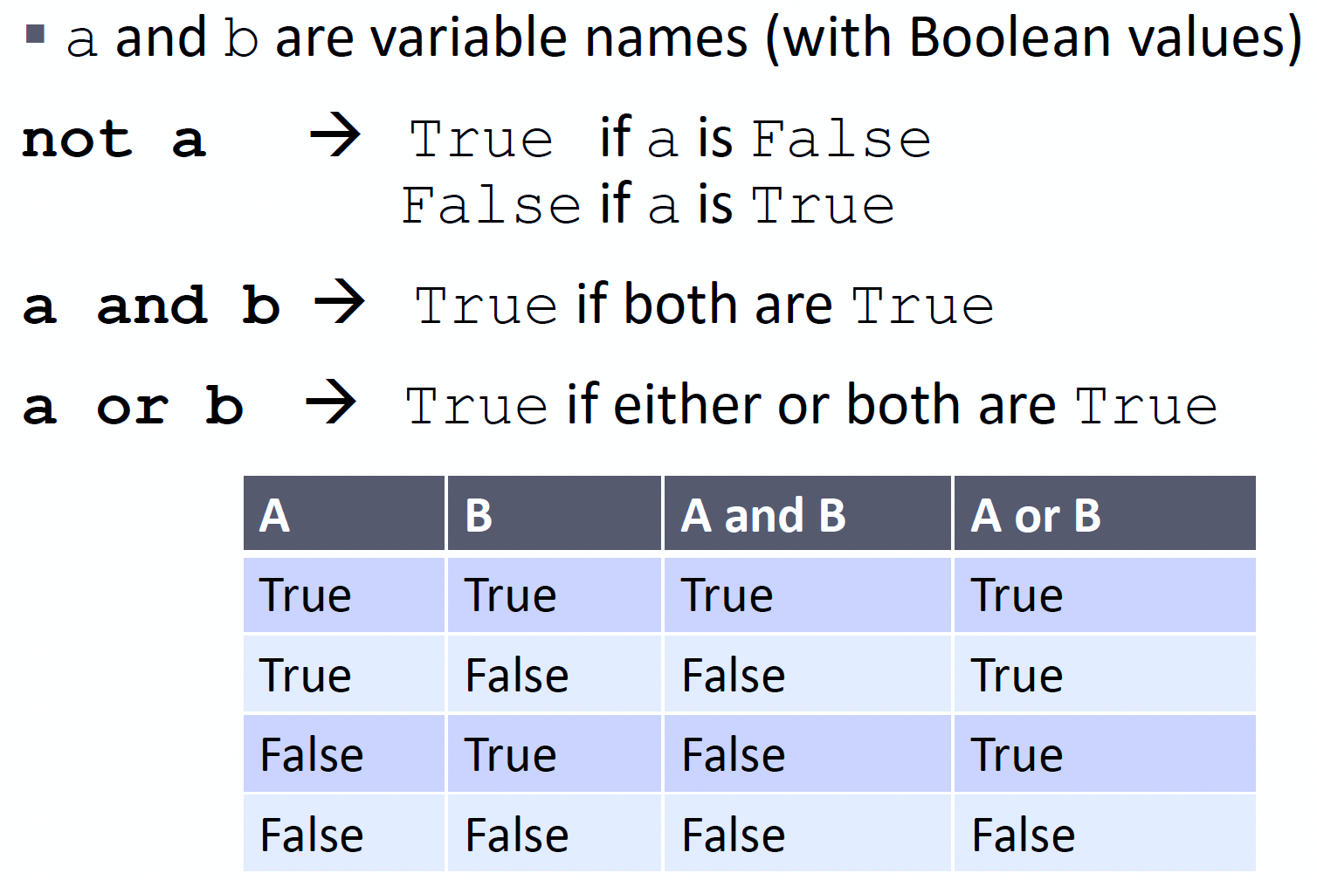
LOGIC OPERATORS

Slide 11
Logical Operators
Operator | Meaning | Example | Result
and | True if both the operands are true | (5 == 1) and (43 >4) | false
or | True if either of the operands is true | (5 != 1) or (9 >= 10) | true
not | True if operand is false | not(5 >= 6) | true

Slide 12
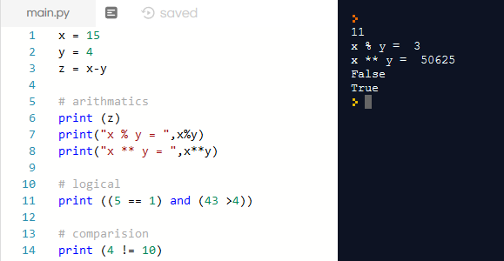
Example

Slide 13
Order of Operations
0rder (High -> Low)
()
**
* / %
+ -
< > <= >= != ==
not
and
or
Example | Result
16 - 2 * 5 / 2 + 1 | 12
10 * 5 + 2 / (8 + 2) | 50.2
45 % 10 / 2 | 2.5
10 - 4 * 2 | 2
(10 - 4) * 2 | 12
(12 + 0 ) - 4 > 2 * 3 / 4 | true

Slide 14
Decisions
  A decision lets you run either one section of code or another, based on the results of a specific test
  In python, we have the following decisions statements :
    if statement
    else statement
    elif statement

Slide 15
Decisions: if statement
  It executes some code only if a specified condition is true
  Syntax:
  if condition:
  statement(s) to be executed if condition is true
  Note
  The statements inside the if will be indented

Slide 16
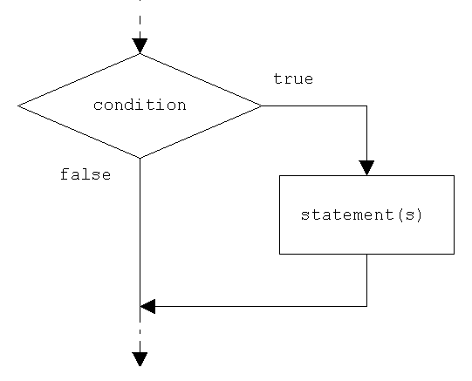
Decisions: if statement

Slide 17
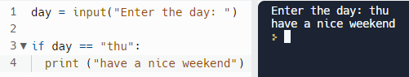
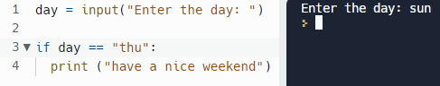
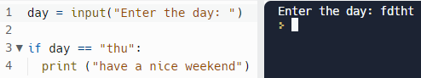
Decisions: if statement
  Enter the day (sun, mon, …) then check: if the day is thu, print (have a nice weekend)

Slide 18
Decisions: else statement
  It execute some code if a condition is true and another code if false
  Syntax:
  if condition:
  statement(s) to be executed if condition is true
  else:
  statement(s) to be executed if condition is false

Slide 19
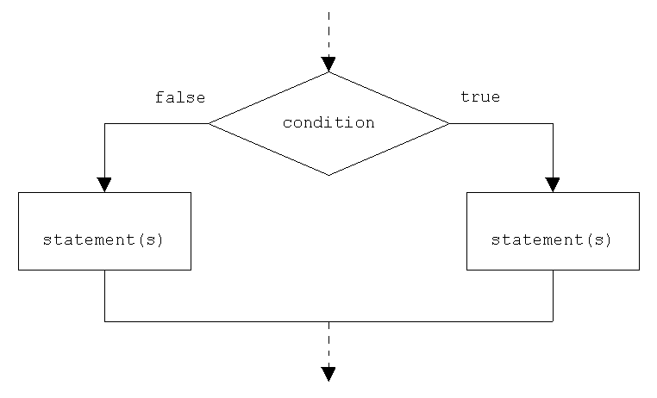
Decisions: else statement

Slide 20



Decisions: else statement
  Enter the day (sun, mon, …) then check: if the day is thu, print (have a nice weekend), otherwise print (have a nice day)

Slide 21
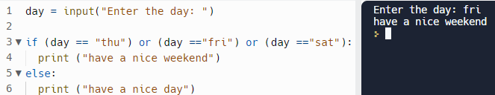


Decisions: else statement
  Enter the day (sun, mon, …) then check: if the day is thu, fri, or sat, print (have a nice weekend), otherwise print (have a nice day)

Slide 22
Decisions: elif statement
  It is used to perform different actions based on different conditions
  Syntax:
  if condition1:
  statement(s) to be executed if condition1 is true
  elif condition2:
  statement(s) to be executed if condition2 is true
  :
  else:
  default statement(s) to be executed if all conditions are false

Slide 23
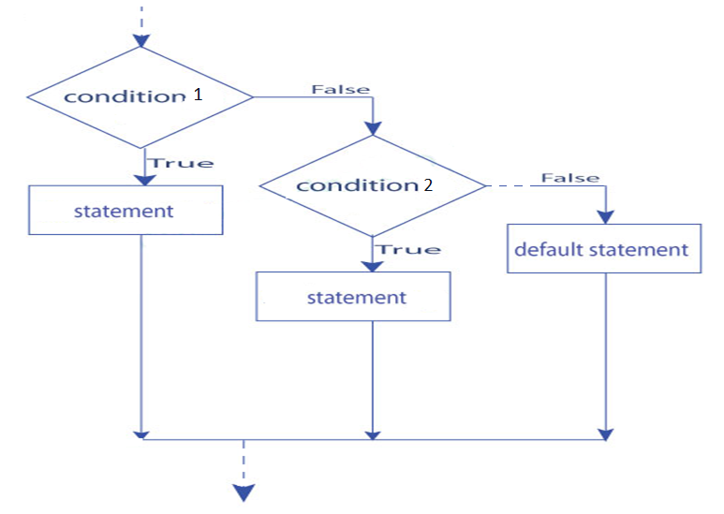
Decisions: elif statement

Slide 24
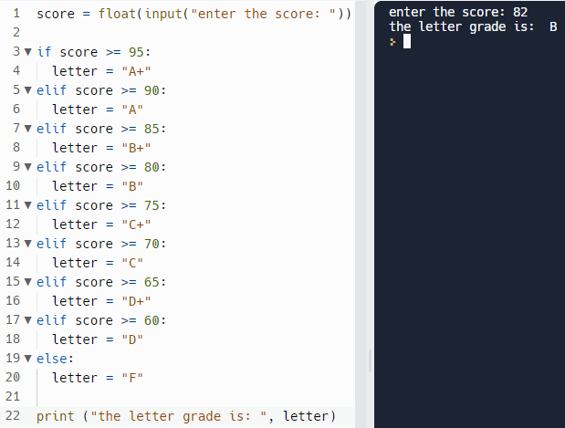
Decisions: elif statement
  Enter a student score, then print its letter grade (A+, A, B+,…)

